Slide 1
PROYECTO DE PROGRAMACION
ANCHI DUEÑAS HAIRTON ANDREE
VALERO MEDINA ANDRO ERICK
SEMINARIO SERNA LUIS

Slide 2
NFA

Slide 3
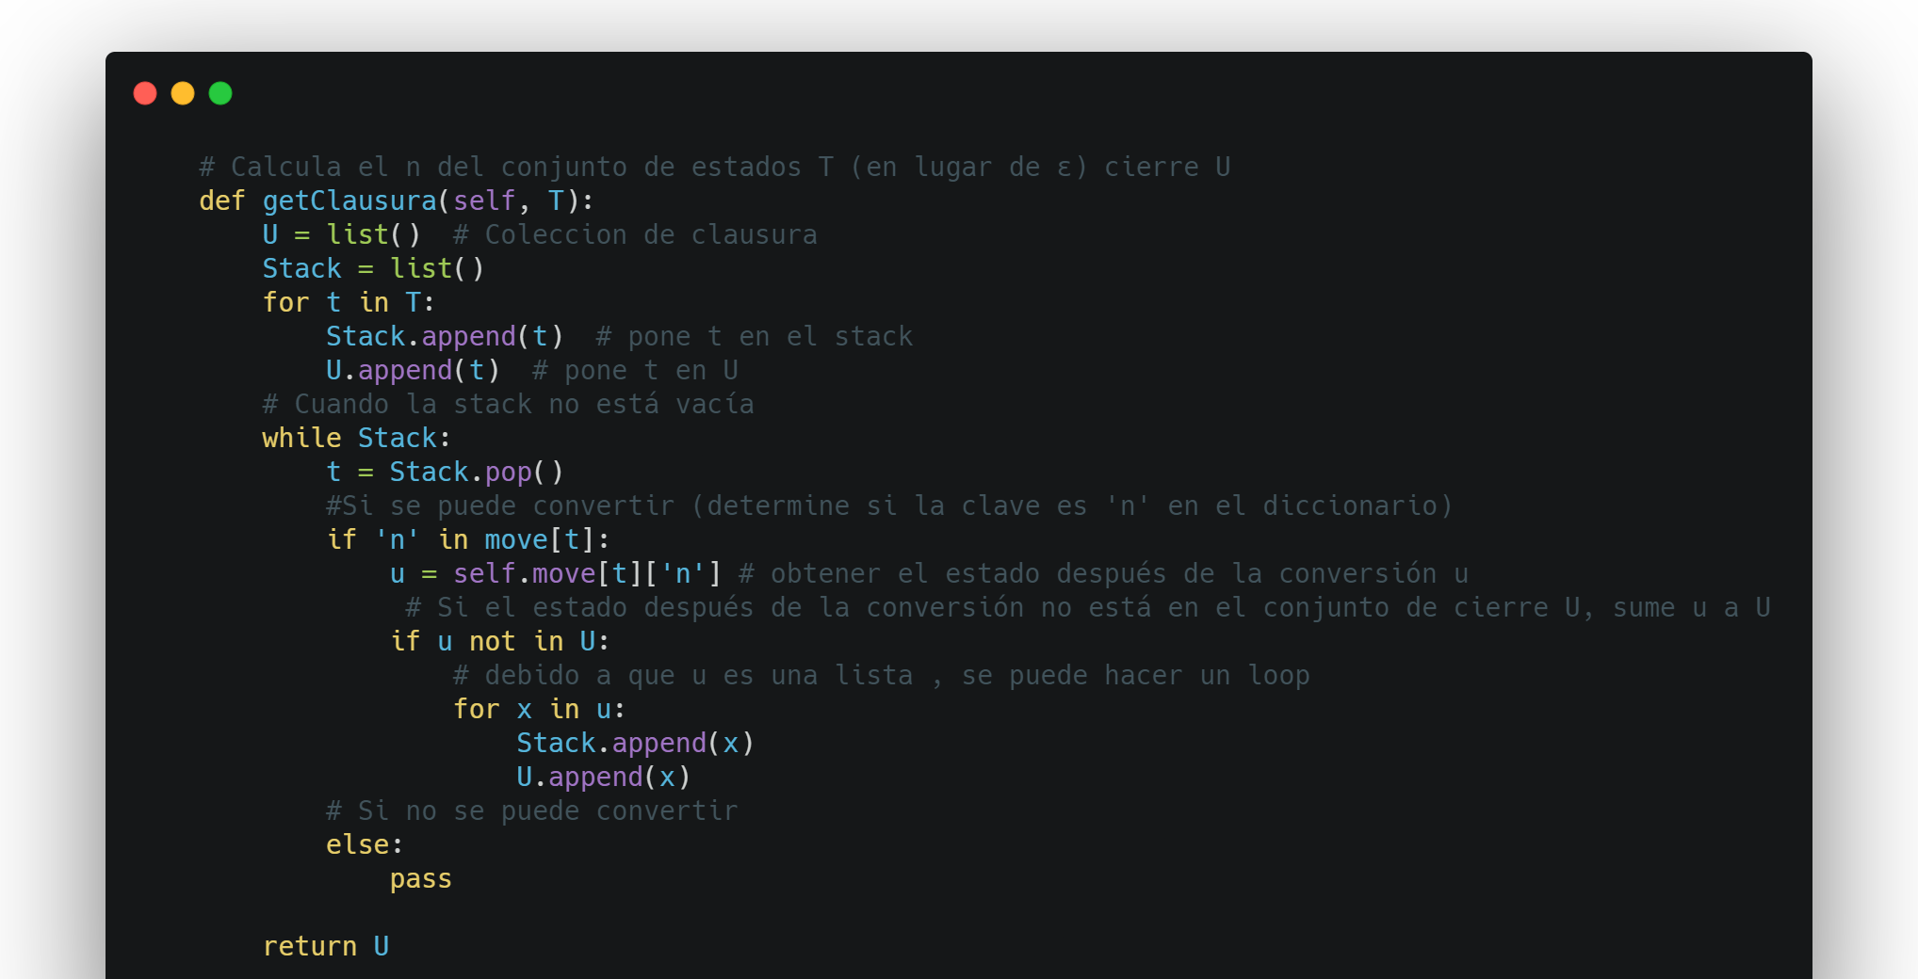

Slide 4
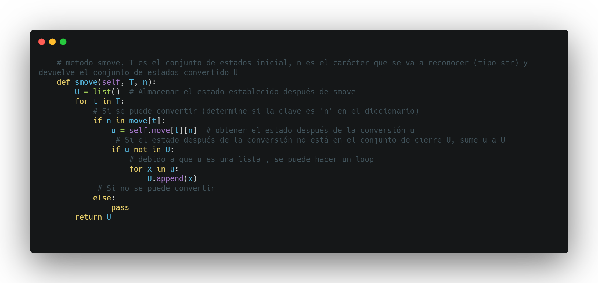

Slide 5
DFA

Slide 6
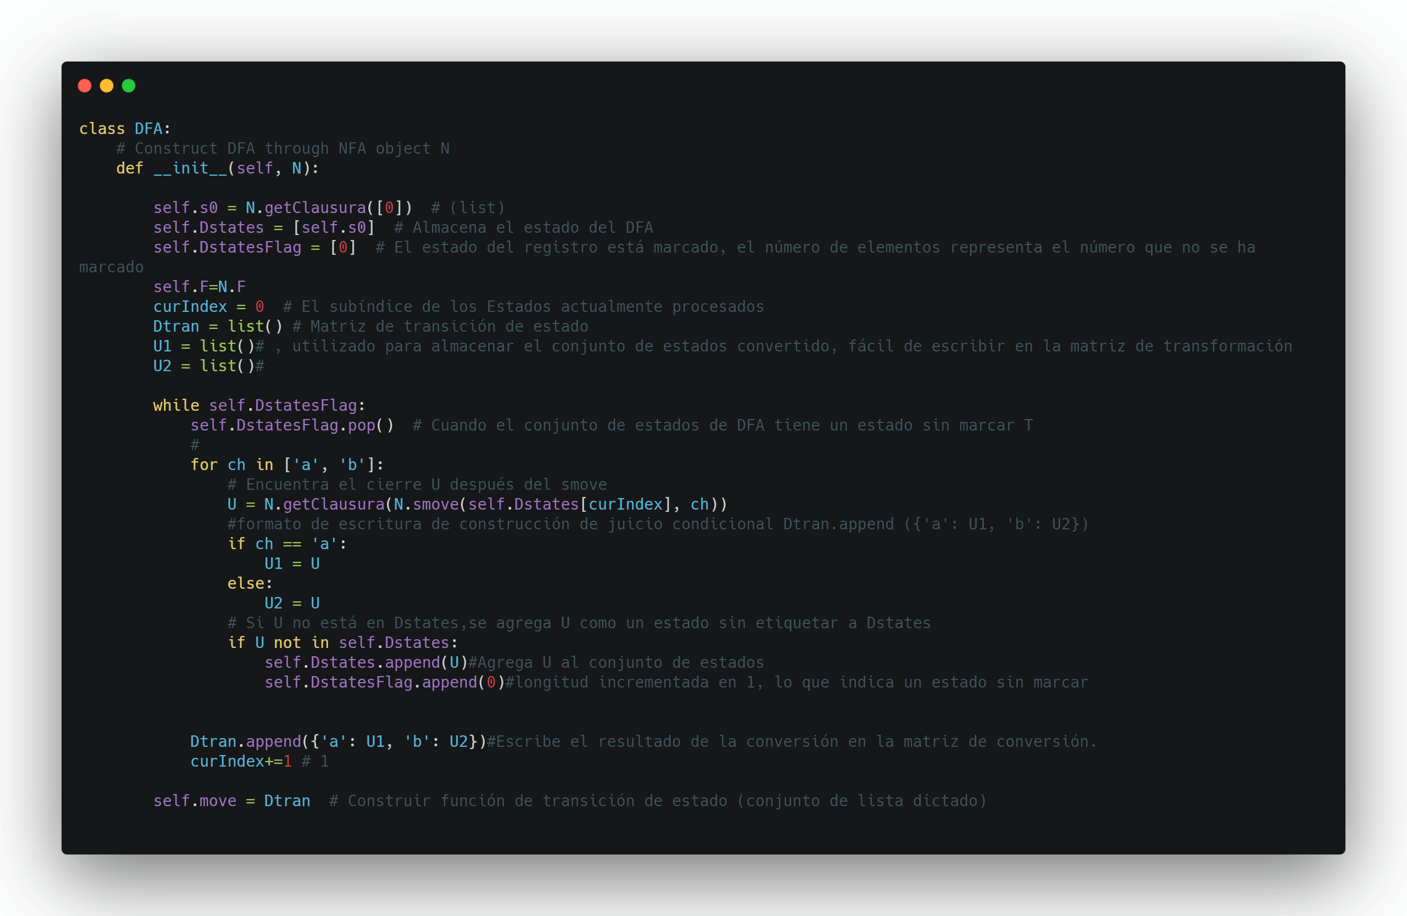

Slide 8
Matriz de transición e-AFND
[{'n': [1, 7]},
{'n': [2, 4]},
{'a': [3] },
{'n': [6], },
{'b': [5]},
{'n': [6]},
{'n': [1, 7]},
{'a': [8]},
{'b': [9]},
{'b': [10]},
{}]
Estados DFA: [
[0, 1, 7, 2, 4], S
[8, 3, 6, 1, 7, 2, 4], B
[5, 6, 1, 7, 2, 4], C
[9, 5, 6, 1, 7, 2, 4], D
[10, 5, 6, 1, 7, 2, 4]] E
Matriz de transición DFA: [
S ==={'a': B 'b’: C},
B ==={'a': B, 'b': D},
C ==={'a': B, 'b': C},
D ==={'a': B, 'b': E},
E ==={'a': B, 'b': C}]

